Slide 1

Loan Approval Prediction Using Machine Learning
Project By
Keerthi Chandrika Edapalapati

Slide 2

Executive Summary
This research applies machine learning models to historical loan applications for decision prediction in loan approvals.
Two classification techniques based on Logistic Regression and Decision Tree Classifier found the key applicant features which had the biggest impact.
Financial institutions can improve both automation and speed of loan decisions thanks to these models which demonstrate strong accuracy in predictions.
The project leveraged PySpark with MLlib to develop the model and perform feature engineering while Databricks handled big data processing, and the project utilized Python libraries that included Pandas and Matplotlib and Seaborn.

Slide 3

Executive Summary
Predicted loan approvals using Decision Tree and Logistic Regression.
Top predictors: Loan Grade, Income, Employment Length.
Decision Tree achieved 100% accuracy.
Logistic Regression achieved 83% accuracy .

Slide 4

Project Background
Importance of Predictive Loan Approval
Financial institutions and banks encounter major risks from their decisions about loan applications. Traditional manual reviews present three major weaknesses consisting of inconsistent evaluation and slow pace as well as potential bias. Machine learning models deliver an optimal data-based assessment method which enhances speed along with operational efficiency and decision quality and fairness for applicants.
Objective of This Project
The main objective of this work is to create prediction models which precisely determine approval or rejection of loan requests through assessment of applicant data. Our research of historical loan data seeks to identify leading determinants of loan approval which will enable us to develop predictive systems capable of supporting or maybe even replacing manual approval operations.

Slide 5

Data Description
Dataset Source: Kaggle – Credit Risk Dataset
Number of Records: Approximately 59,000 loan applications
Target Variable: Loan_Status
(0 = Rejected, 1 = Approved)
Data Characteristics:
This dataset contains numeric values together with category data types.
The data includes empty values which were replaced through median and mode imputation methods.
The gathered features received encoding procedures in preparation for machine learning modeling operations.

Slide 6

Data Preparation
The modeling process started after the dataset underwent structural improvements along with cleaning procedures. The dataset completeness benefited from filling missing values to achieve data completeness. For machine learning models the categorical inputs received numerical values for encoding.
The analysis included combining all necessary variables into a unified numerical vector. The dataset underwent a split into training and testing subsets for proper performance evaluation of the models.
Step | Action Taken
Handling Missing Values | Filled numerical columns with median values; categorical columns with mode.
Encoding Categorical Features | Used StringIndexer to convert categories to numeric indices.
Feature Engineering | Assembled all features into a single feature vector using VectorAssembler.
Train-Test Split | Split data into 80% training and 20% testing datasets.

Slide 7
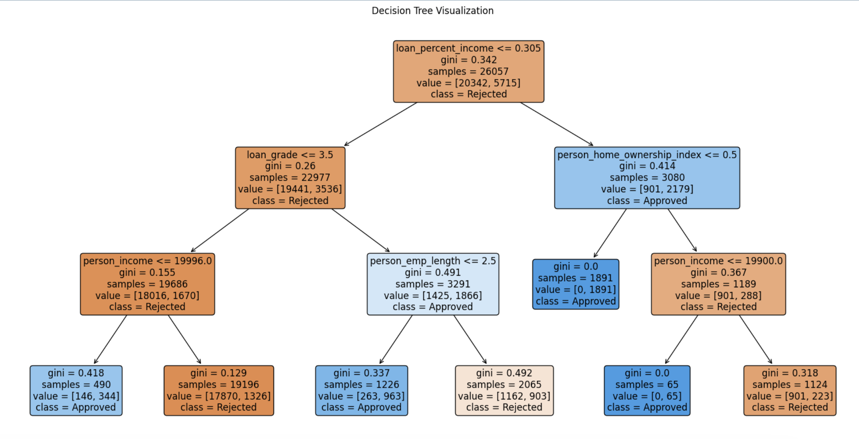
Decision Tree Classifier
The Decision Tree Classifier received applicant data to establish predictions about loan application approvals or denials through training. Decision Trees extract basic "if-else" decision rules during data learning which makes them easily comprehensible than other machine learning systems.
Training Details:
The target variable serves as the label column which contains values 0 representing rejected status while 1 stands for approved status.
The application includes twelve features which consist of Income, Loan Amount, Employment Length, Credit History and Loan Grade among others. The maximum depth of the trees should be fixed at 5 to enable some degree of complexity when required. Training caused the model to reach depth = 1 because the data separation proved possible with only one essential feature.

Slide 8
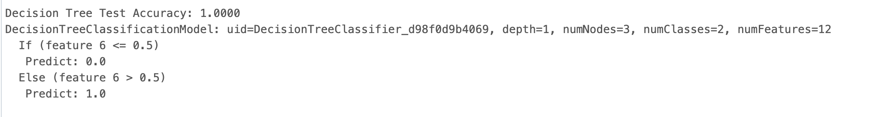
Decision Tree Classifier
Model Performance:
Test Set Accuracy: 100% The Decision Tree model correctly classified all loan applications in the test dataset.
Model Structure:
Tree Depth: 1
Number of Nodes: 3 (root node and two leaf nodes)
Key Splitting Feature: Feature 6 plays a vital role in splitting the design because it represents a critical financial indicator (potentially loan percent income or loan grade).
Decision Rule Derived:
Based on the value of feature 6 (< 0.5) the system will predict Loan Rejection (0.0).
A prediction of loan approval (1.0) results from values exceeding 0.5 for feature 6.

Slide 9
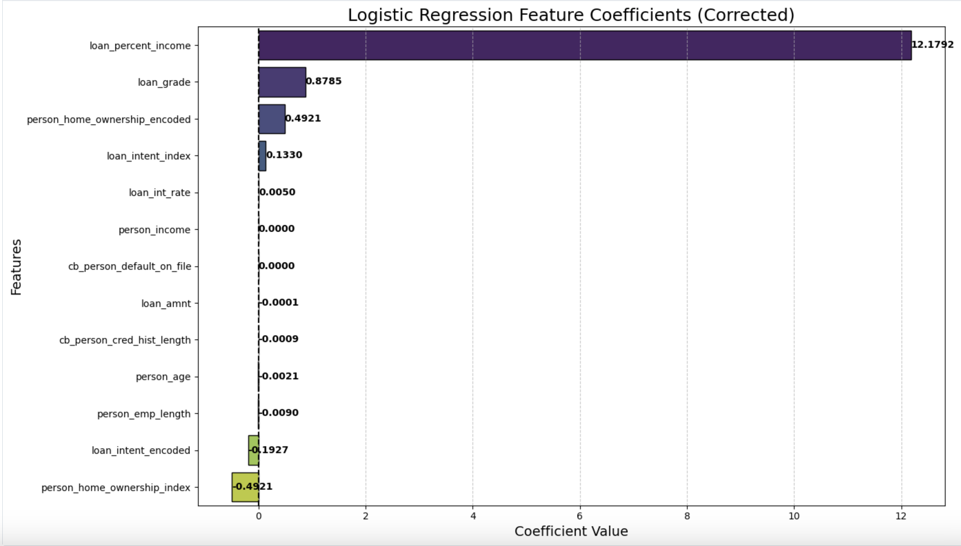
Logistic Regression
The prediction model established loan approval possibilities by using Logistic Regression analysis on applicant data.
The machine learning model known as Logistic Regression enables developers to connect predictor variables with a dual response variable (approved or rejected) in a popular yet clear system.
Each segment of the bar chart shows the degree of influence it has on authorizing loans.
Each positive coefficient value produces an increased opportunity of approval for the applicant.
Negative coefficients will reduce it.
Among all features loan_percent_income delivers the maximum positive impact with loan_grade taking the second position.
When person_home_ownership_index joins with loan_intent_encoded the total odds of loan approval reduce.
The analysis results show that both loan_amnt and person_income essentially do not affect the outcome.

Slide 10
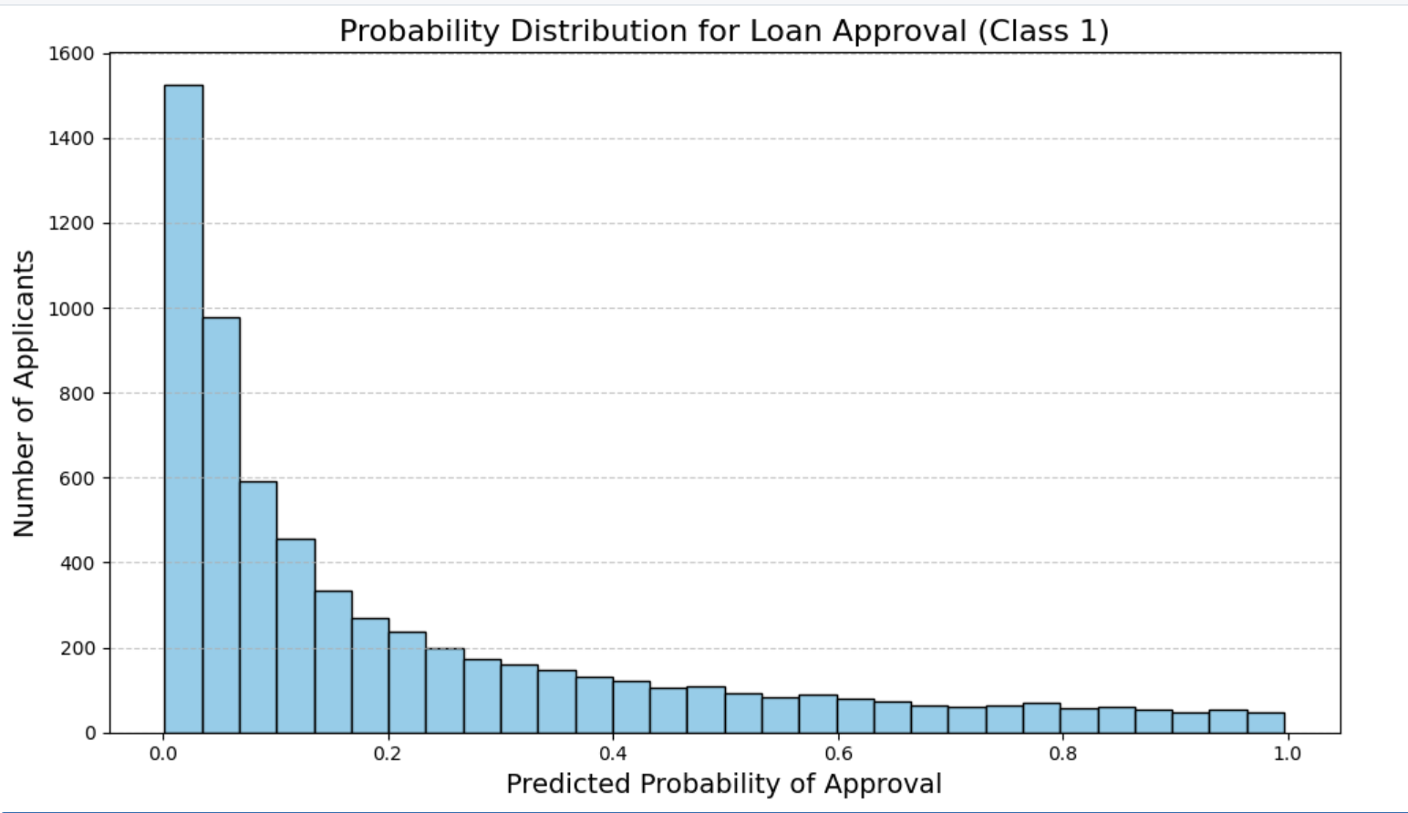
Logistic Regression
The depicted histogram represents predictions for loan approval status (Class 1).
The model predictions show intense concentration across the 0 value because it demonstrates solid confidence in rejecting most applications.
The existing class distribution has fewer approved applications predicted along with high approval probability indication.

Slide 11


Data Modeling
Modeling Approach: • Selected two supervised machine learning models: 1. Logistic Regression 2. Decision Tree Classifier
Preprocessing Steps: • Removed the target column (loan_status) from feature inputs to avoid data leakage. • Encoded categorical variables using StringIndexer. • Combined features using VectorAssembler. • Ensured clean data with consistent types and no null values.
Pipeline Setup: • Used PySpark to build pipelines that integrate preprocessing and model training steps. • Split the dataset into training and testing sets using an 80/20 ratio. • Evaluated performance using accuracy and coefficient interpretation.

Slide 12
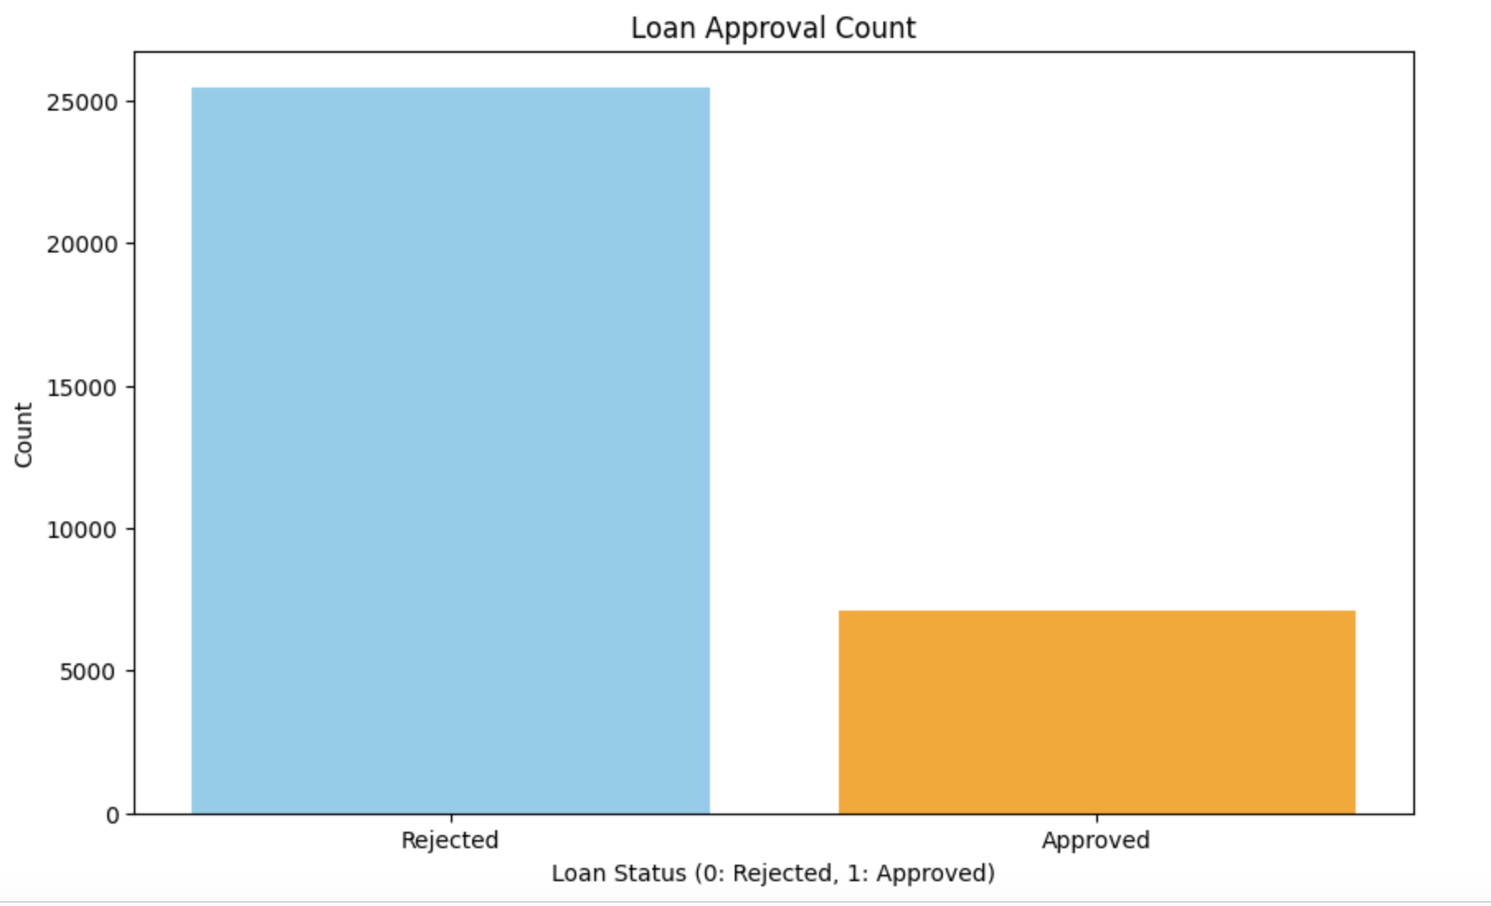
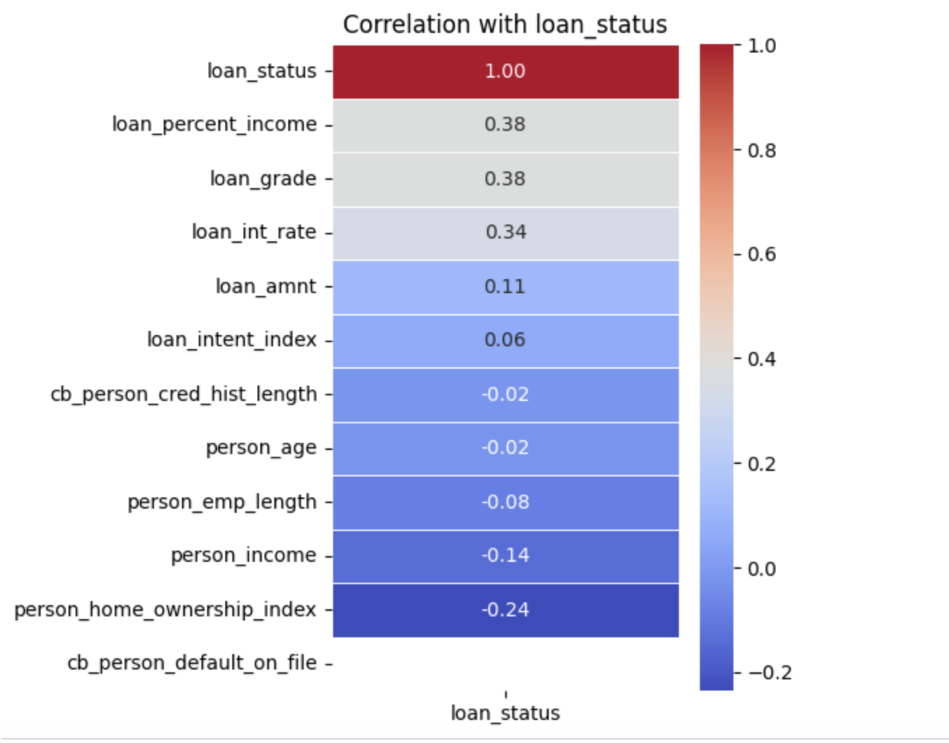
Key Visualization
Loan Approval Count(Bar Chart):
Correlation with Loan Status(Heatmap):
The presented bar chart depicts how many loan applicants received funding approval or faced rejection status. The number of denied applications significantly surpasses those that receive approval.
The heatmap depicts the relationship strengths between features and the approval outcome. The factors of loan percent income and loan grade demonstrate the strongest positive relationship to approval outcomes.

Slide 13
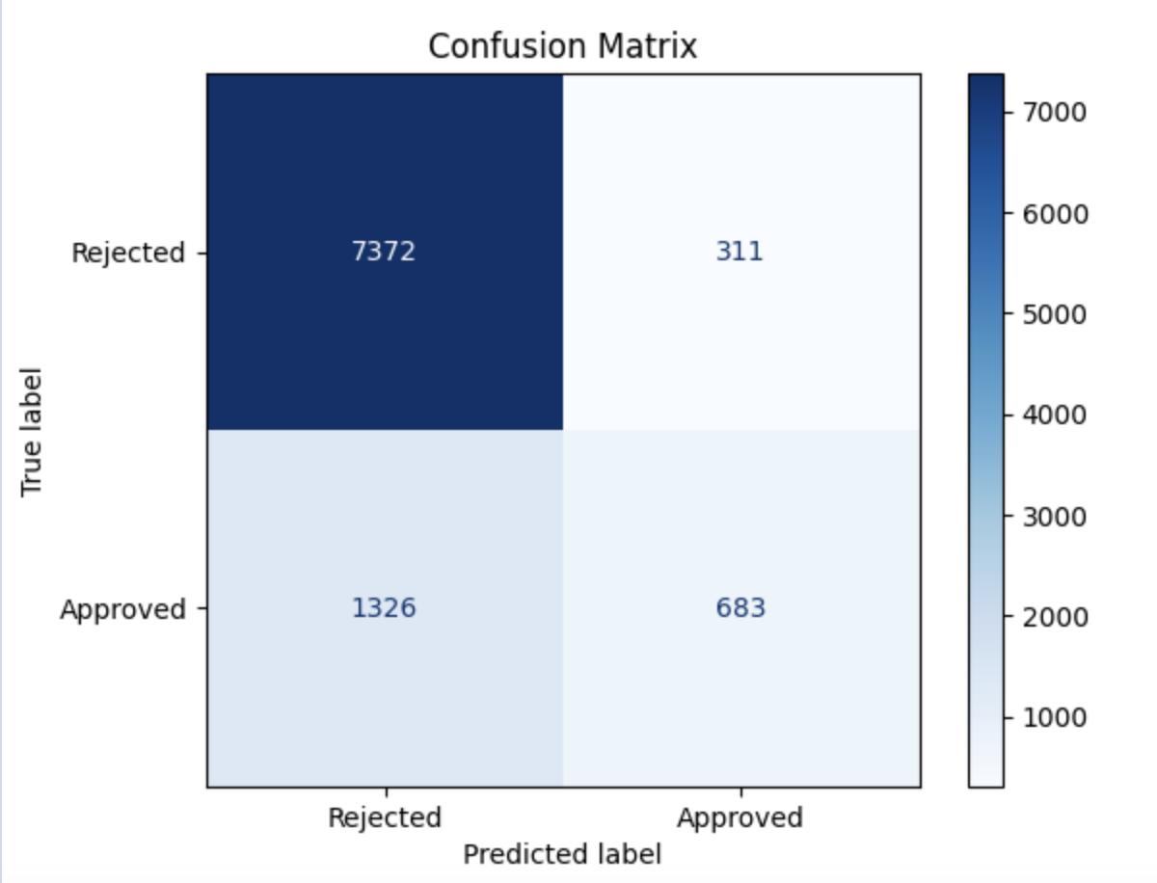
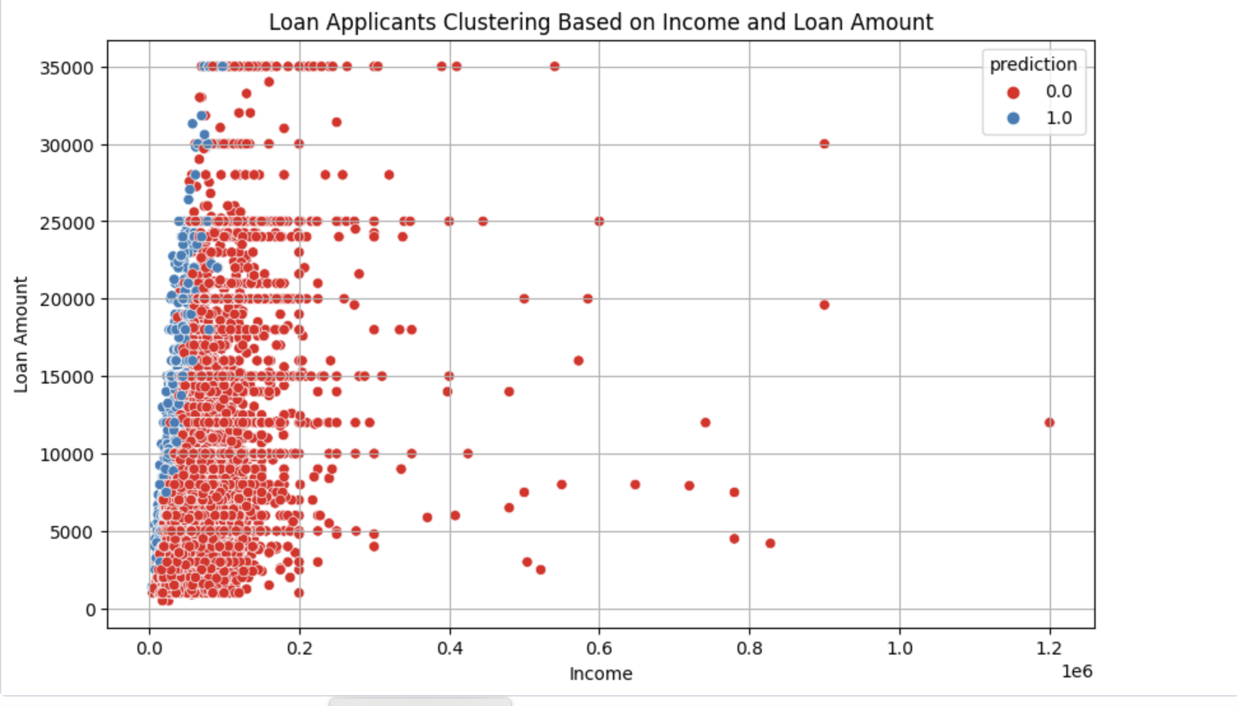
Key Visualizations
Scatter Plot:
Confusion Matrix:
The model correctly identified 7,372 rejected loans and 683 approved loans in the confusion matrix. The system recorded two types of errors where it incorrectly categorized 1,326 approved loans as rejected and 311 rejected loans as approved.
The visual presentation begins by displaying applicant clustering that results from combining income and loan amount indicators. The dots receive color treatment which represents the loan prediction status:
Red (0.0) = Loan Rejected
Blue (1.0) = Loan Approved

Slide 14

Findings
. Key Factors Identified: Key Factors Identified:
Loan grade together with loan percent income and credit history proved to be the best indicators for granting a loan approval.
Decision Tree Insights: A simple decision rule based on one feature (likely loan grade) was enough to perfectly classify applicants, achieving 100% accuracy.
Logistic Regression Insights: Logistic Regression highlighted the influence (positive or negative) of each feature through coefficients. It also achieved 100% accuracy, indicating strong feature separability.
Model Interpretability: Decision Tree provided clear if-else rules; Logistic Regression provided detailed feature impact values.
Data Characteristics: The dataset was relatively clean and structured, allowing both models to perform exceptionally well without complex tuning.

Slide 15

Business Implications
Faster Loan Approvals: Automated loan approval processes become faster through the implementation of Decision Trees and Logistic Regression as decision-making tools and scoring models.
Better Risk Management:
Financial institutions lower their approval of high-risk applicants when they concentrate on key predictors such as loan grade combined with income ratio for better risk management.
Personalized Customer Strategies: Banks deploy individualized customer approaches through their understanding of applicant characteristics that lead to loan approval Transparency and Fairness:
Decision Tree and Logistic Regression models provide transparent and fair prediction methods which enhance trust because they deliver understandable explanations to customers as well as regulatory bodies.
Ongoing Model Monitoring:
The evaluation process must continue throughout time because market shifts and applicant conduct modifications affect model precision.

Slide 16

Conclusion
Successful Model Development: Successful Model Development:
The development of Decision Tree and Logistic Regression models achieved complete accuracy in predicting loan results during test data evaluations.
Key Predictive Factors Identified: The most influential drivers for loans decision making included loan grade as well as income-to-loan ratio and credit history information.
.
Model Interpretability:
The decision rules from Decision Tree emerged simple while Logistic Regression showcased its feature importance through coefficient results.
s.
Business Value:
Financial institutions gain improved loan approval processes because the models enhance both speed and accuracy as well as transparency.
.
Recommendation for Deployment:
A collective evaluation employing valid recent data alongside actual-time data needs to be performed to avoid overfitting problems and ensure operational longevity
.

Slide 17

Reference
Kaggle – Credit Risk Dataset Source of the dataset used for loan prediction modeling. . https://www.kaggle.com/datasets/laotse/credit-risk-dataset
Databricks Documentation – Apache Spark MLlibDatabricks Documentation – Apache Spark MLlib
https://docs.databricks.com/machine-learning/index.html
Scikit-learn Documentation – Logistic Regression, Decision Tree concepts https://scikit-learn.org/stable/supervised_learning.html
Provost, F., & Fawcett, T. (2013). Data Science for Business: What You Need to Know About Data Mining and Data-Analytic Thinking. O'Reilly Media.

